Slide 1



Statistical Inferences of Eye movement data using Bayesian smoothing
Junpeng Lao, PhD
Bayes@Lund, 2017-04-20
I am supported by the Swiss National Science Foundation

Slide 2


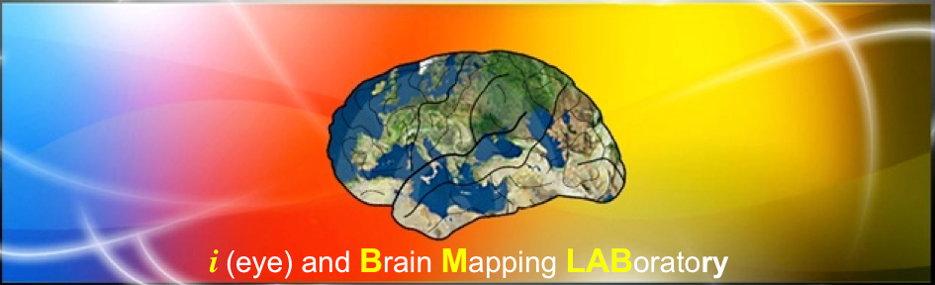


Little bit about myself…
iBMLab

Slide 3
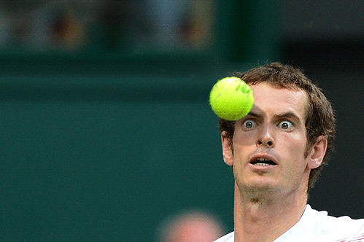
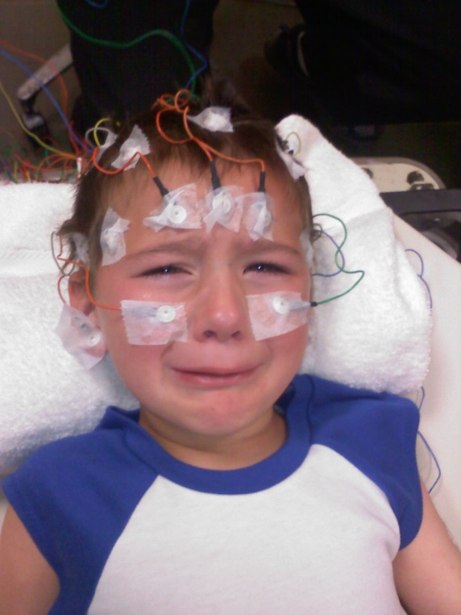
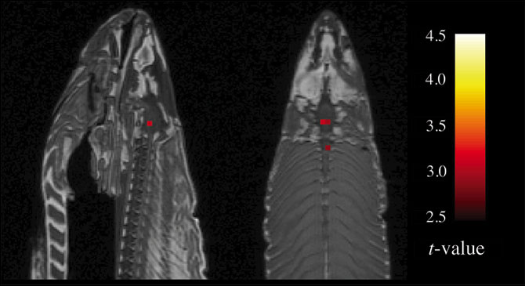
Little bit about myself…
Eye-tracking
EEG
fMRI
https://github.com/junpenglao/
http://junpenglao.xyz

Slide 4
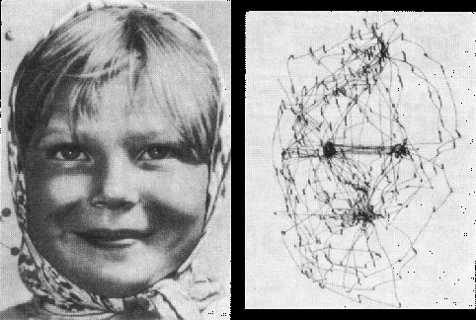
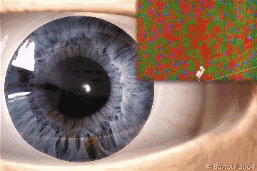
Eye movement
Yarbus, A. L. (1967)
Notes:
Image source:
http://smc.neuralcorrelate.com/research-lines/fixational-eye-movements/

Slide 5
The Question:
Notes:
Image source:
https://flic.kr/p/c1UTf

Slide 6
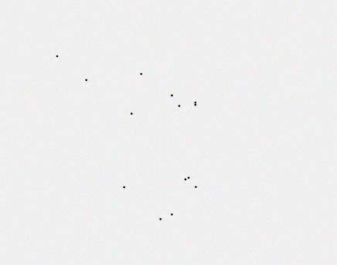
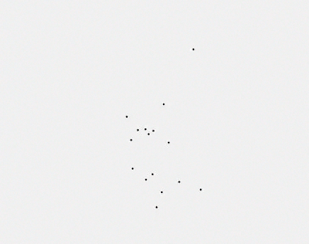
Fixations
Group A
Group B

Slide 7
NHST using ROI:
Group A
Group B

Slide 8
Data-driven analysis
Group A
Group B

Slide 9
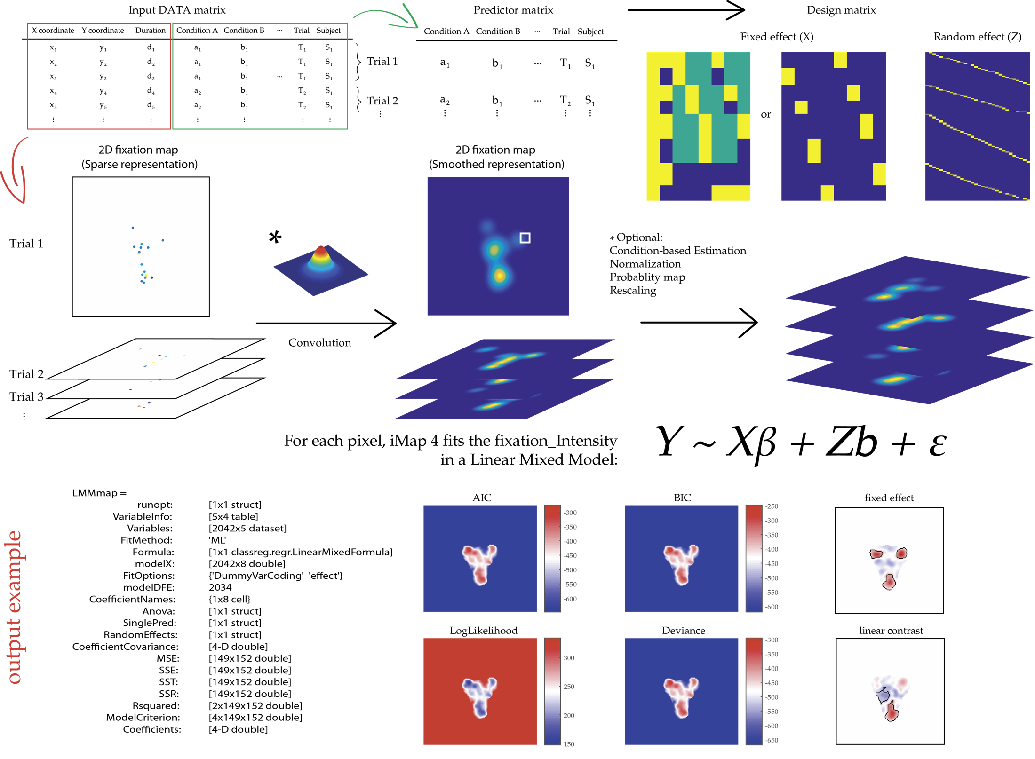
Spatial mapping of fixation data

Slide 10
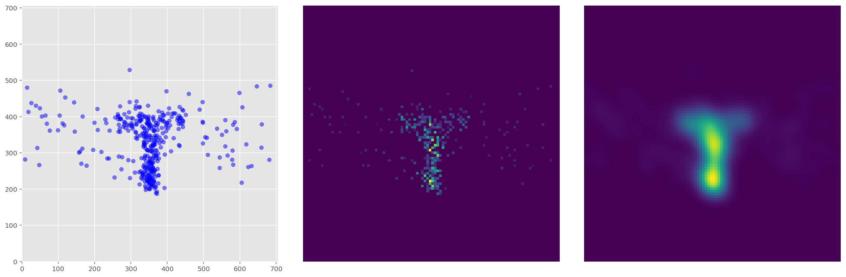
Smoothing

Slide 11
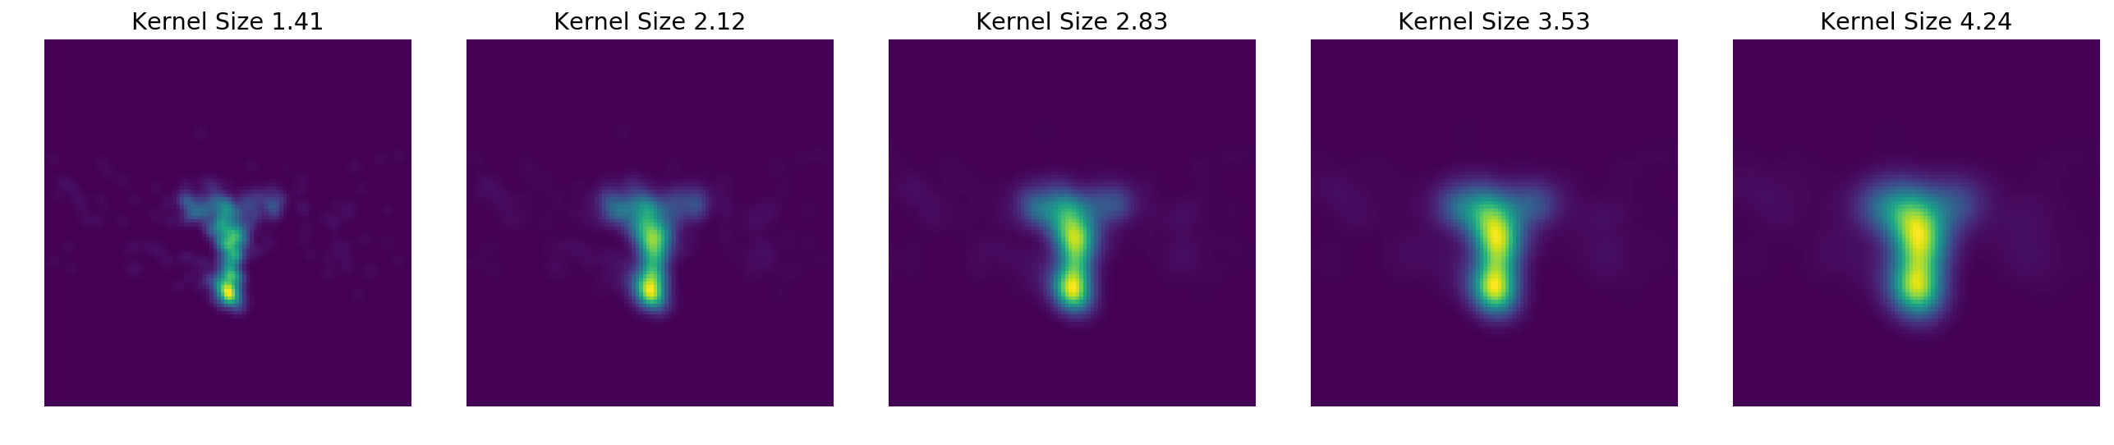
Does size matter?

Slide 12
Rethinking

Slide 13
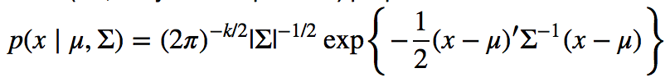
Gaussian Distribution

Slide 14
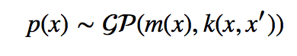
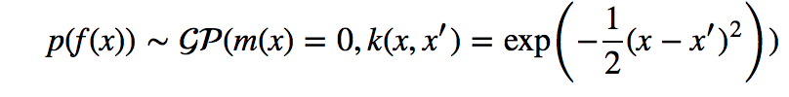
Gaussian Process
Gaussian distribution with infinite dimension

Slide 15
Posterior prediction with GP

Slide 16
Kernels / Covariance functions
Notes:
Figure from GP example in PyMC3 doc

Slide 17
Kernels / Covariance functions

Slide 18
Kernels / Covariance functions
cov_latent = tau * pm.gp.cov.ExpQuad(Dim, length_scale)
cov_noise = sigma2 * tt.eye(n)
Cov_func = cov_latent(X) + cov_noise)()

Slide 19
GP regression on fixation data
cov_latent = tau * pm.gp.cov.ExpQuad(2, 1°)
cov_noise = sigma2 * tt.eye(n)
Cov_func = cov_latent(X) + cov_noise)()

Slide 20
GP regression on fixation data

Slide 21
GP regression on sparse data

Slide 22
GP regression on sparse data

Slide 23
GP regression on fixation data

Slide 24
GP regression on fixation data
Informative Prior on length scale: ls ~ LogGaussian (mu = 1°, sd)

Slide 25
GP regression on fixation data
Informative Prior on length scale: ls ~ LogGaussian (mu = 1°, sd)

Slide 26
Overthinking:
what is smoothing, really?

Slide 27
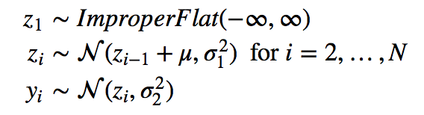
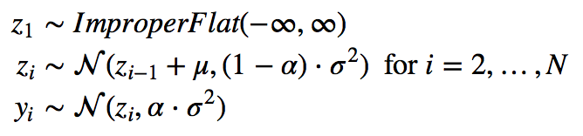
Overthinking:
what is smoothing, really?

Slide 28
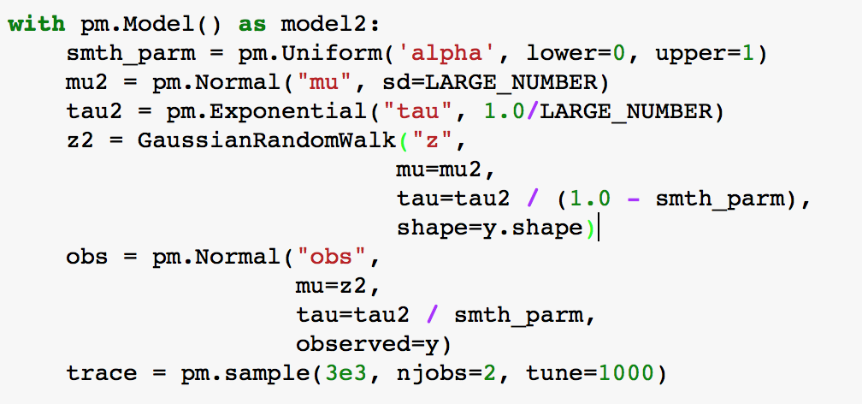

Slide 29
Moving forward
Scale up to more dimensions
Finer grid
Temporal information
Hierarchical model
Subject effect, multiple conditions, etc.
How wrong is it using Gaussian Process to model fixation data?
Dirichlet process?
Unify model for both Fixation number and fixation duration:
Poisson Process for fixation number at location (x, y)
Gamma distribution for fixation duration (waiting time)

Slide 30
Thanks!
More information could be found on my Github repository:
junpenglao/Bayesian_Smoothing_EyeMovement

Slide 31
Bonus slide
Is it help to have mean function?

